Slide 1
How to register a new RAWCS project
Notes:
Welcome to a presentation on how to register a new RAWCS project.

Slide 2
To register a new project you must have the full support of a Rotary Club from an Australian Rotary District.
The Project Manager and the Deputy Project Manager must be active members of the sponsoring Rotary Club.
The Committee Member may be a non-Rotarian or a Rotarian from outside the sponsoring Club.
All project registrations are now exclusively online. Please commence your application on this page:
http://rawcs.org.au/register-projects/
Notes:
To register a new project you must have the full support of a Rotary Club from an Australian Rotary District.
The Project Manager and the Deputy Project Manager must be active members of the sponsoring Rotary Club.
All project registrations are now exclusively online. Please commence your application on this page:
http://rawcs.org.au/register-projects/

Slide 3
Please ensure you read all the requirements in the Project Criteria before you proceed to registration.
Remember to save your application often – especially before moving to the next page. All red asterisks must turn to green ticks before you submit the application.
Don’t be impatient – wait for the save or submit to finalise before leaving the page or logging off.
Notes:
Please ensure you read all the requirements in the Project Criteria before you proceed to registration or you will not be able to Save any information you input.
Remember to save your application often – especially before moving to the next page. All red asterisks must turn green before you submit the application.
Don’t be impatient – wait for the save or submit to finalise before leaving the page or logging off.

Slide 4
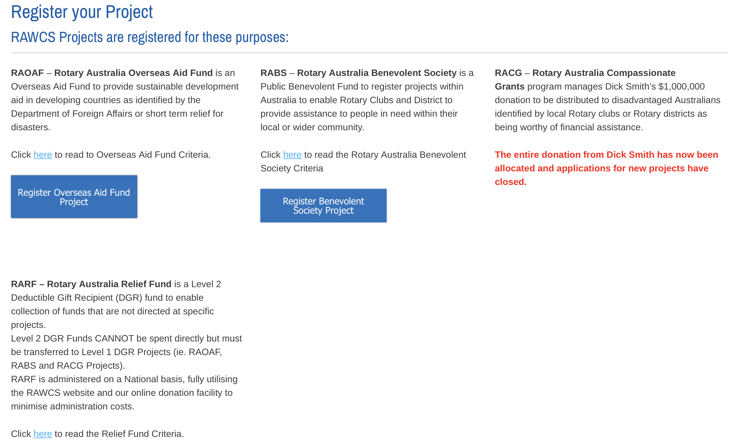
Notes:
The link quoted brings you to this page where you can choose the type of project:
Rotary Australia Overseas Aid Fund Project (RAOAF)
Rotary Australia Benevolent Society Project (RABS)
Rotary Australia Compassionate Grant Project (RACG) – No longer available
Rotary Australia Relief Fund – These Projects can only be opened on the authority of the RAWCS Executive

Slide 5
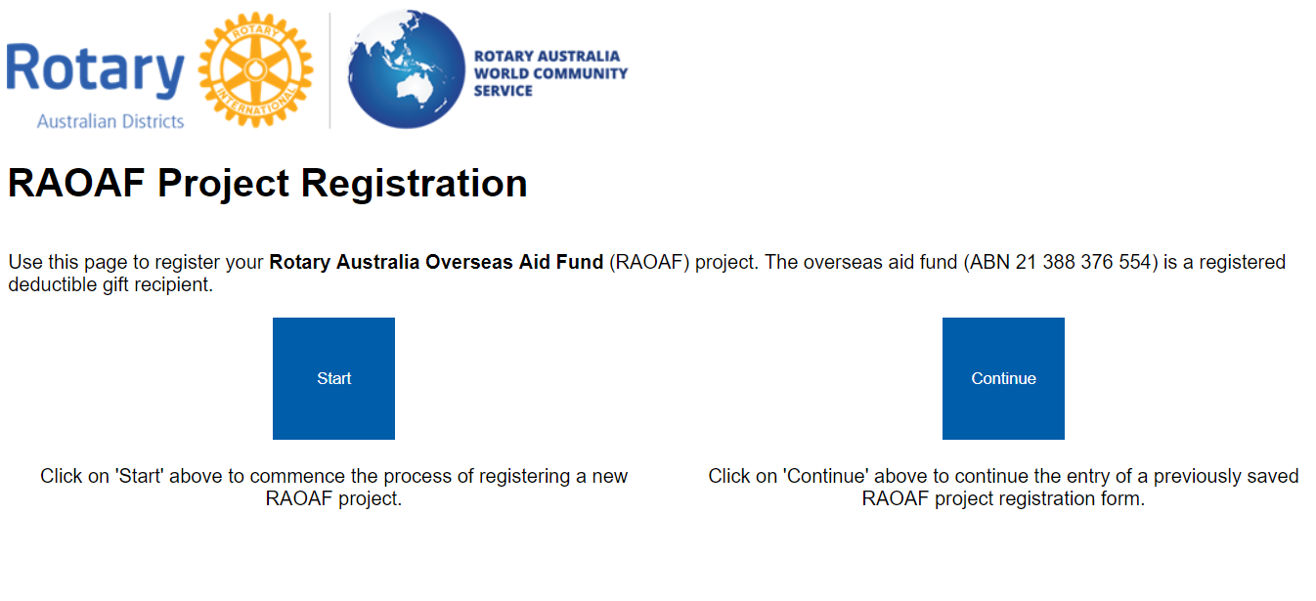
Notes:
If this is a new registration click on START
If you are returning to add to or complete an application that you have saved, please click on CONTINUE

Slide 6
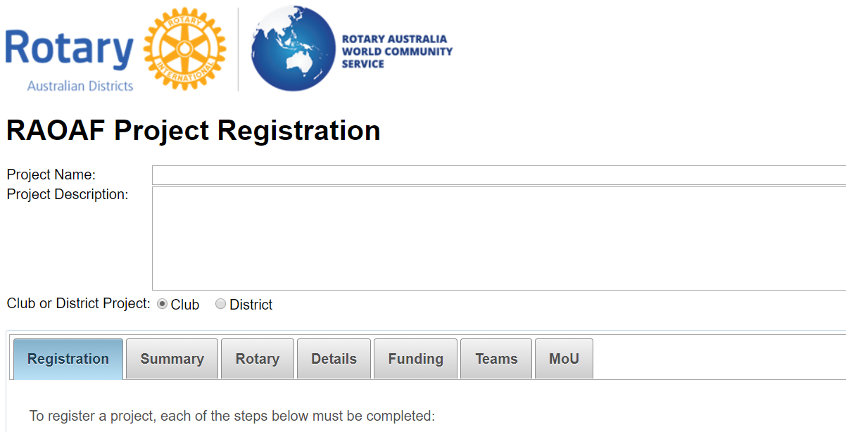
Notes:
This is an application for a RAOAF project and includes more detail as it requires details of an overseas Rotary Club of Organisation.
It gives a good example of what you will asked for in any of the other types of project registration applications.
Please enter a short descriptive name for the project including the location or country you will operate in. You are limited to 100 character spaces.
Enter a short description of the project. You are limited to 500 character spaces. Enter if a Club or District project.
If you ever wish to change the name, description, Project Manager or Deputy Project Manager after registration it can only be done by getting your Project Manager to email a requested change to with all the new details to the National Projects Manager.
Please note the 6 tabs that all have to be completed. Remember that all red asterisks must change to a green tick before the application can be submitted

Slide 7
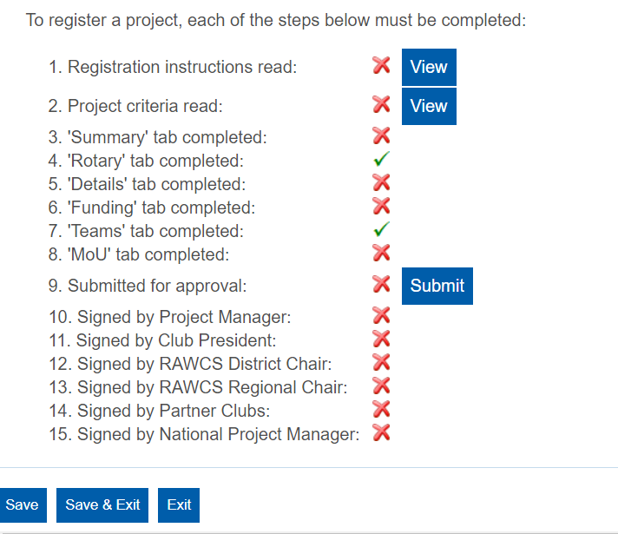
Notes:
You MUST open and read both the registration instructions and Project Criteria or you will not be able to save any input. We recommend that you download both files to your computer so that you can easily refer to them.
When all red crosses turn to green ticks the project will be automatically registered and notification emails sent to all relevant personnel notifying them of the registration.
The program will tell you what is missing most times and will make suggestions to assist you.
Now commence entering the summary.

Slide 8
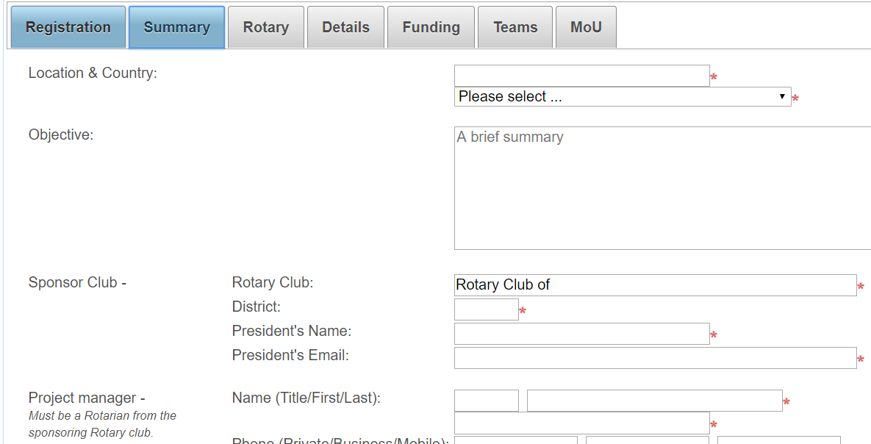
Notes:
The Summary is first.
Select the country of the project from the drop down list.
Enter a brief summary of your project objectives, details of the sponsoring Rotary Club, Project Manager and Deputy Project Manager MUST be active members from the Sponsoring Rotary Club.

Slide 9
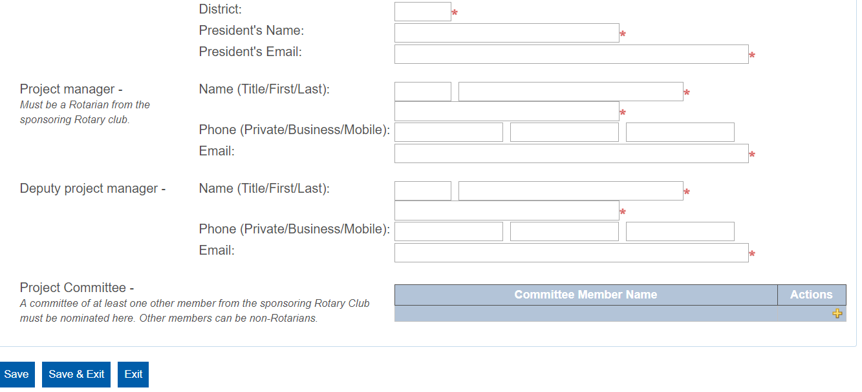
Notes:
The Committee Member/s may be Rotarians from any Club or non-Rotarians.

Slide 10
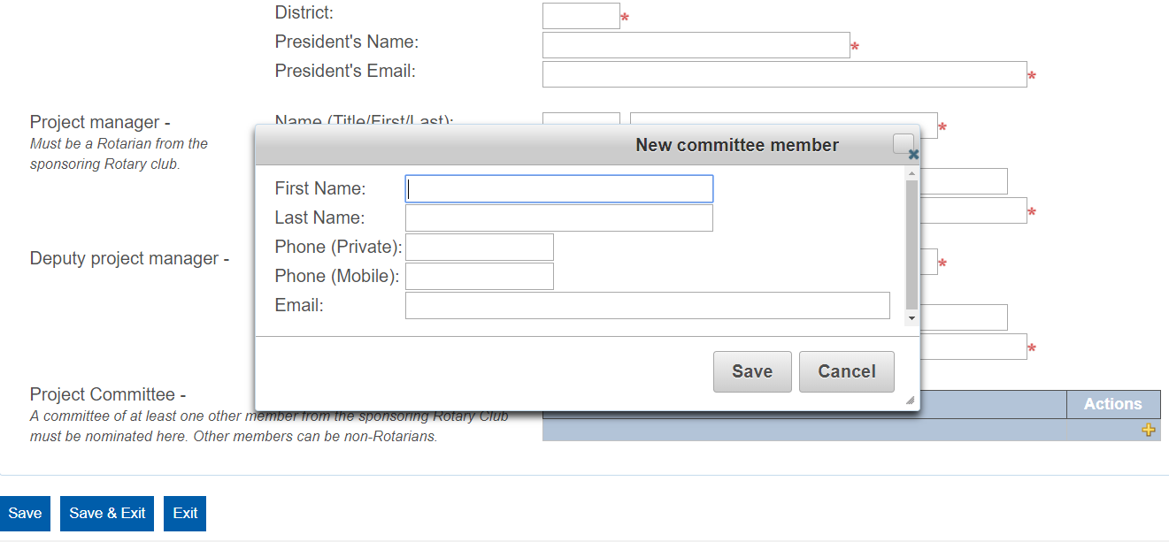
Notes:
Click on the yellow plus sign on the right side of the Committee box and a pop up will appear.
Enter each member of your Project Management Committee and their details.
Your sponsoring Rotary Club Board must approve of all these appointments.

Slide 11
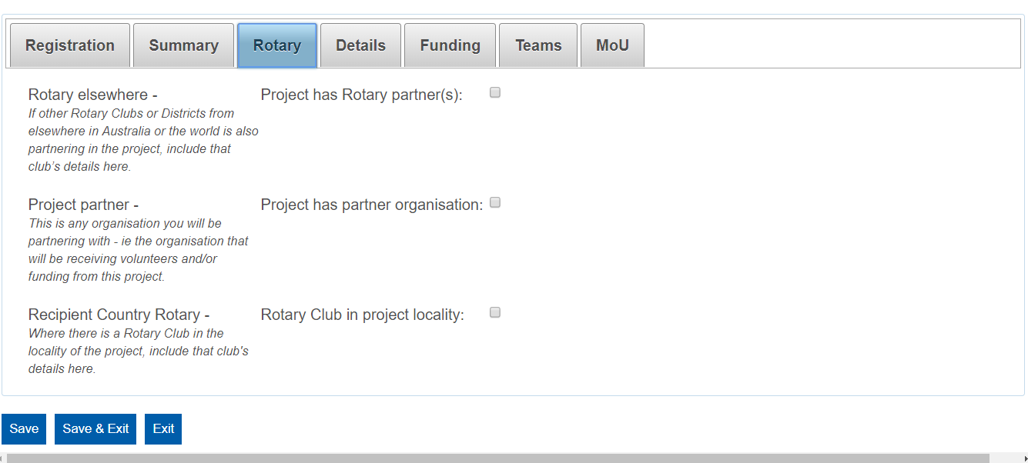
Notes:
By ticking the boxes at the left hand side to enter details of each:
Any other Australian Rotary Club that is involved with the project.
Any partner organisation that is assisting you or helping administer the project overseas
Any Rotary Club involved with the project in the recipient country.

Slide 12
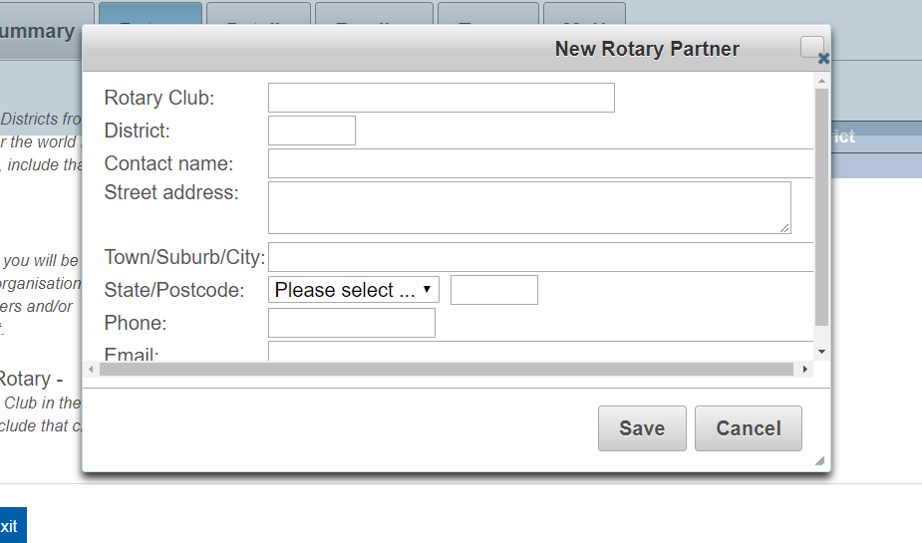
Notes:
Add a Rotary partner Club or District in Australia

Slide 13
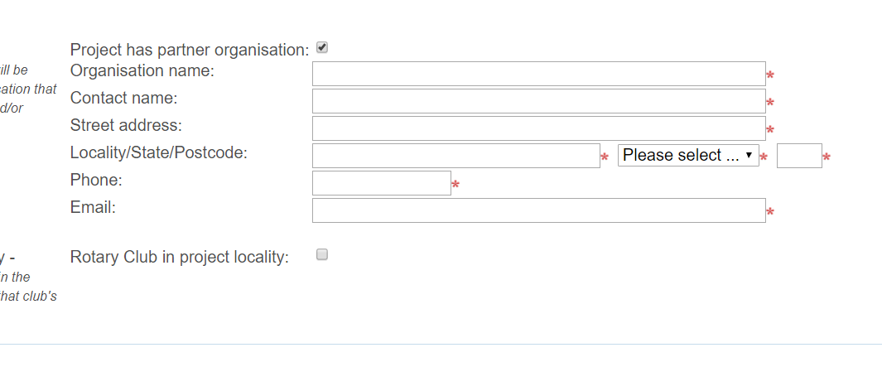
Notes:
Add a partner organisation either in Australia or overseas.

Slide 14
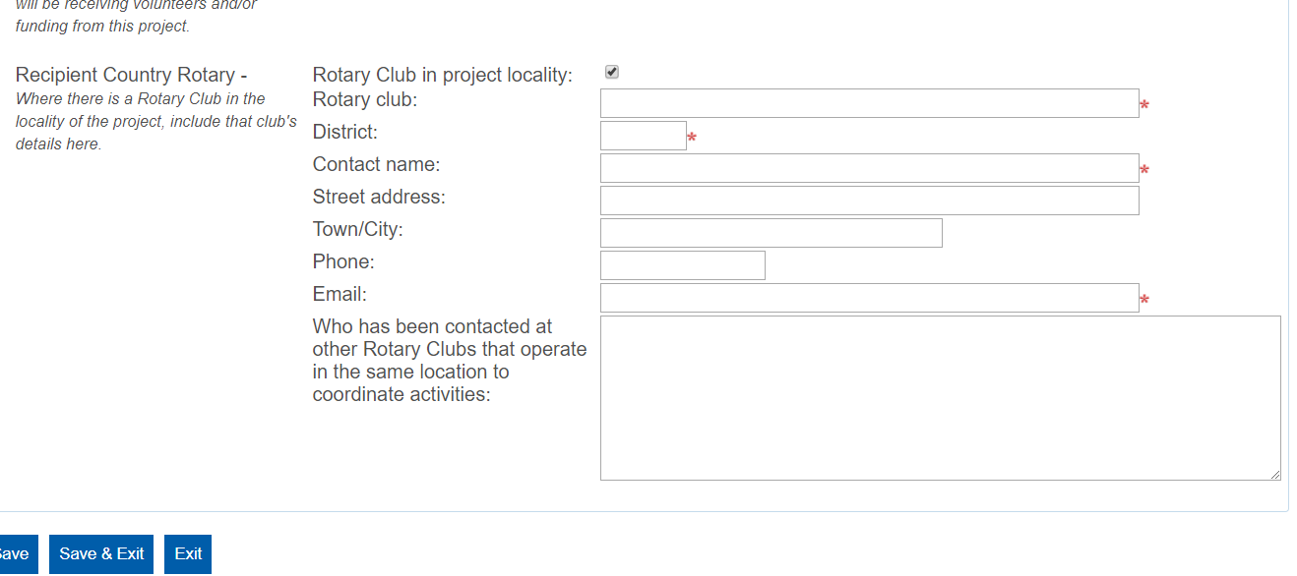
Notes:
Add details of any Rotary Clubs in the recipient country involved in the project.

Slide 15
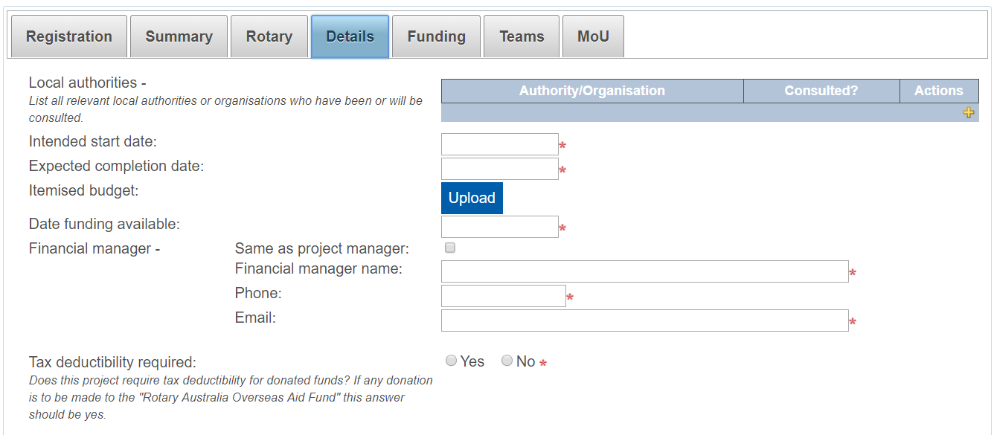
Notes:
Enter the detail about the project including uploading a WORD, Excel or PDF file containing an itemised budget for the project.

Slide 16
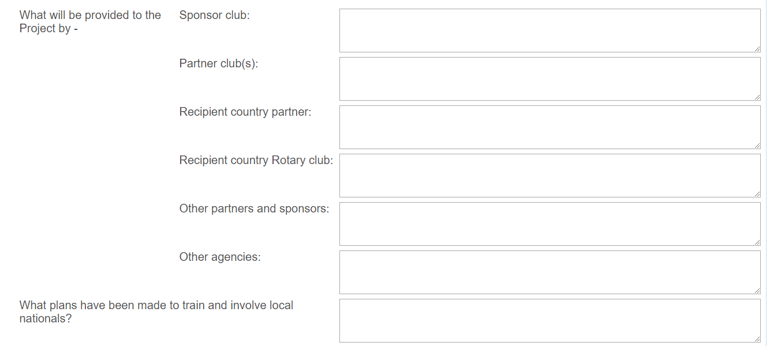
Notes:
More details
If you consider that a requested item is not needed for your project you can write NA (Not applicable) but not where an item has a red asterisk.

Slide 17
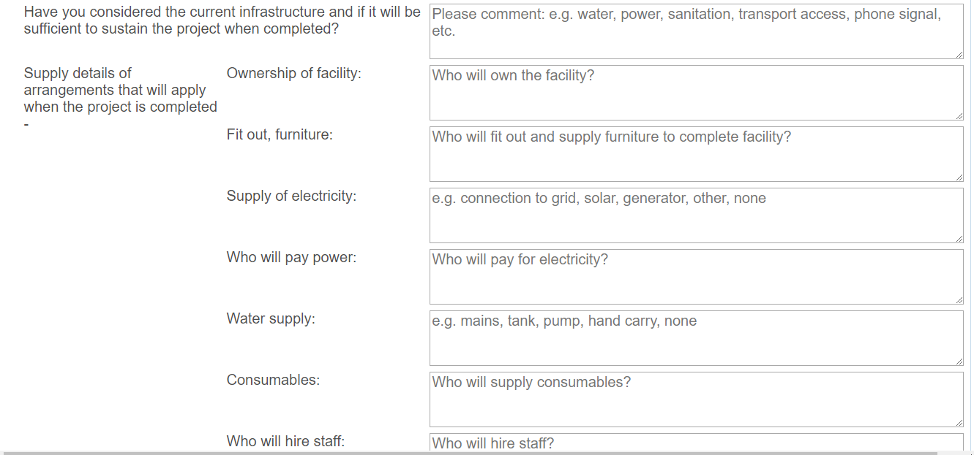
Notes:
More details

Slide 18
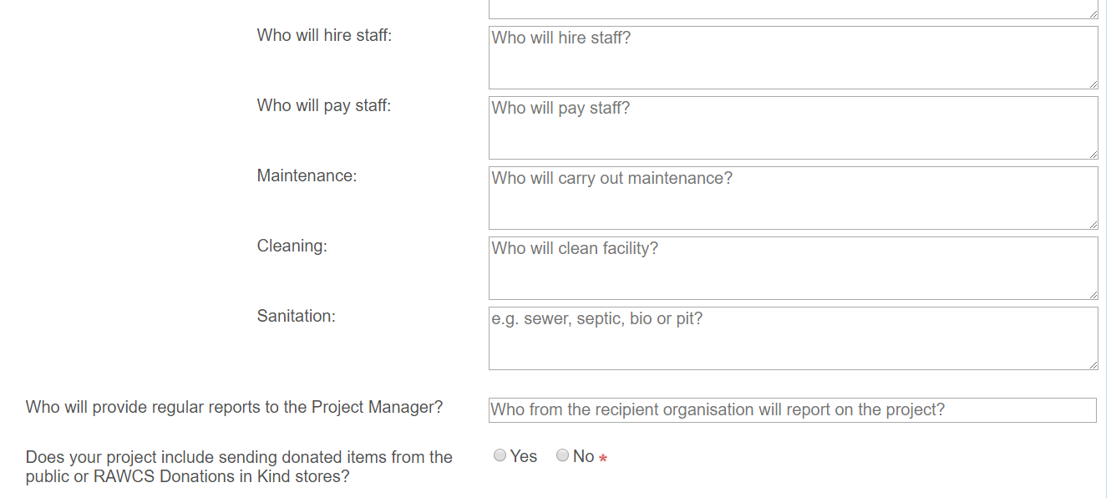
Notes:
More details

Slide 19
Notes:
More details

Slide 20
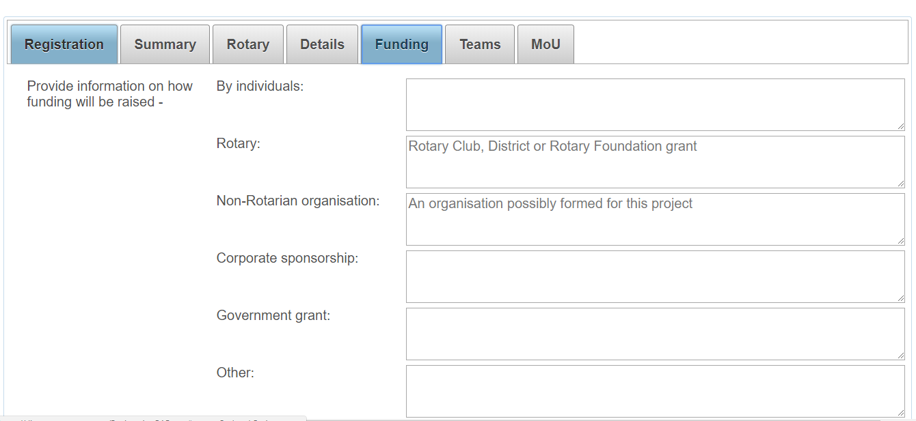
Notes:
Details of funding for the project.

Slide 21
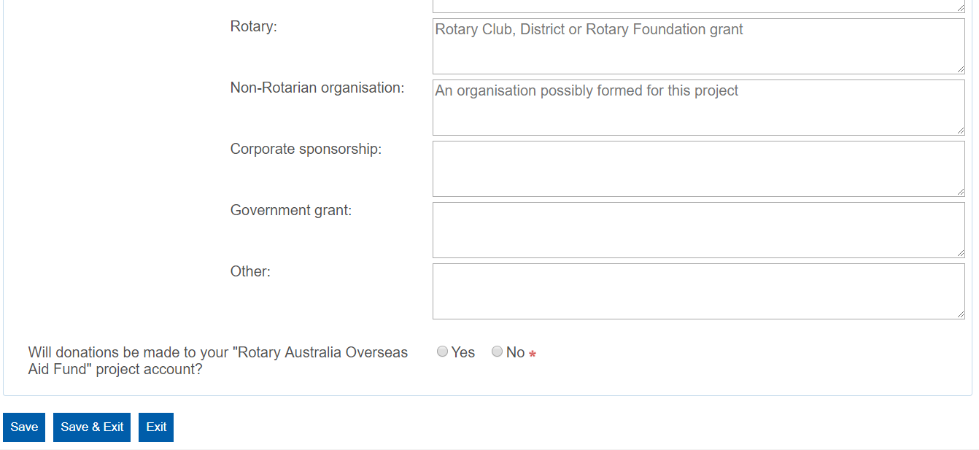
Notes:
More details of funding for the project.

Slide 22
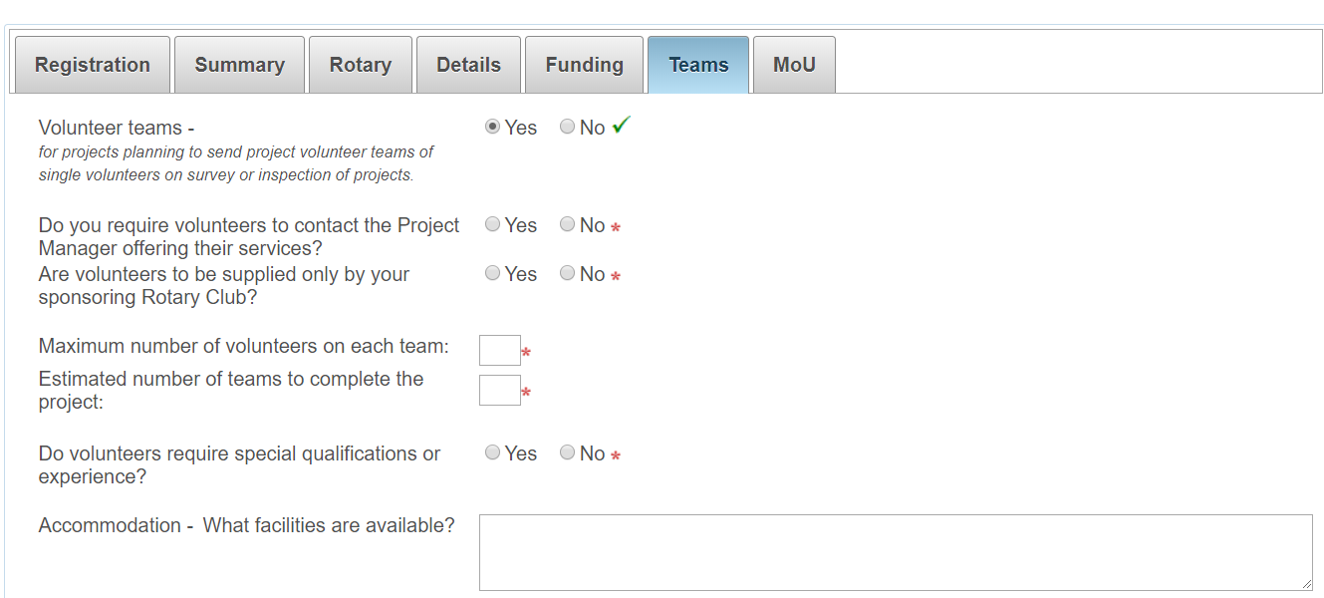
Notes:
If your project will involve volunteers travelling from Australia to an overseas destination click on “YES” and enter the details.

Slide 23
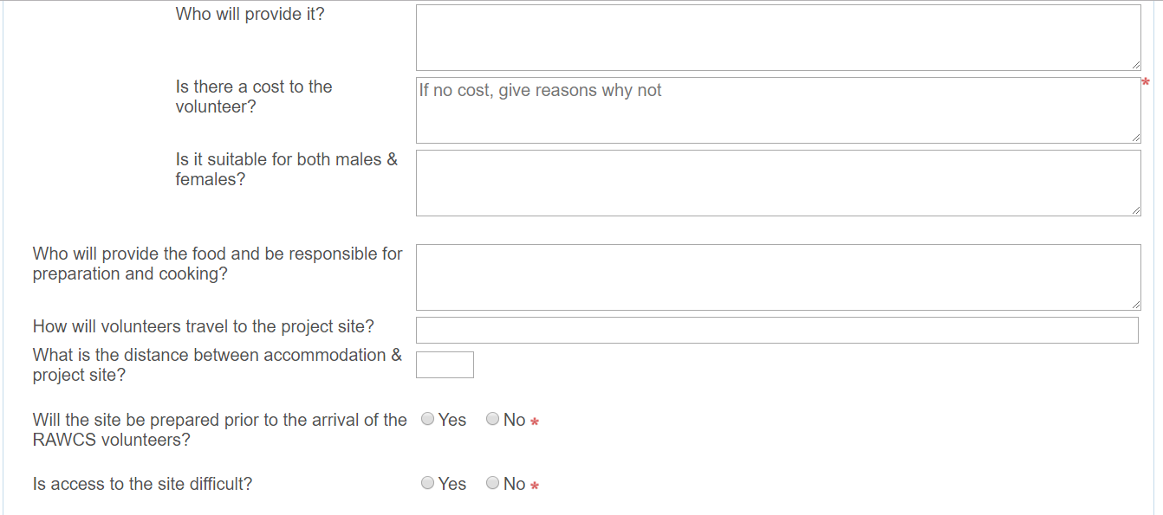
Notes:
More details on volunteers.

Slide 24
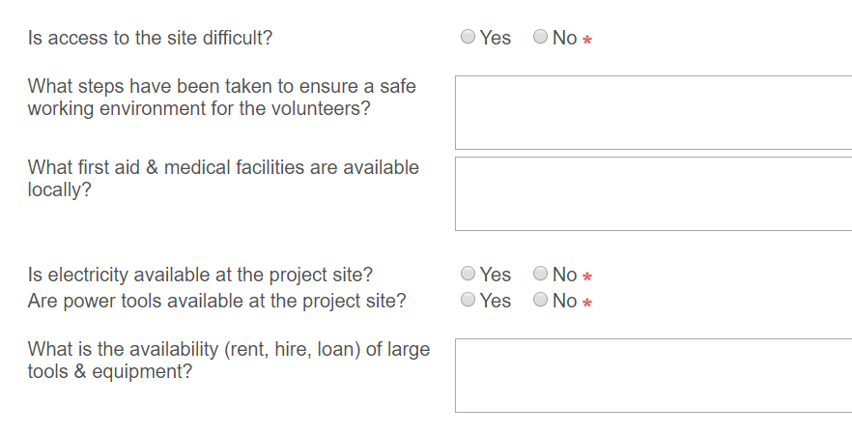
Notes:
More details on volunteers.

Slide 25
Notes:
More details on volunteers.

Slide 26
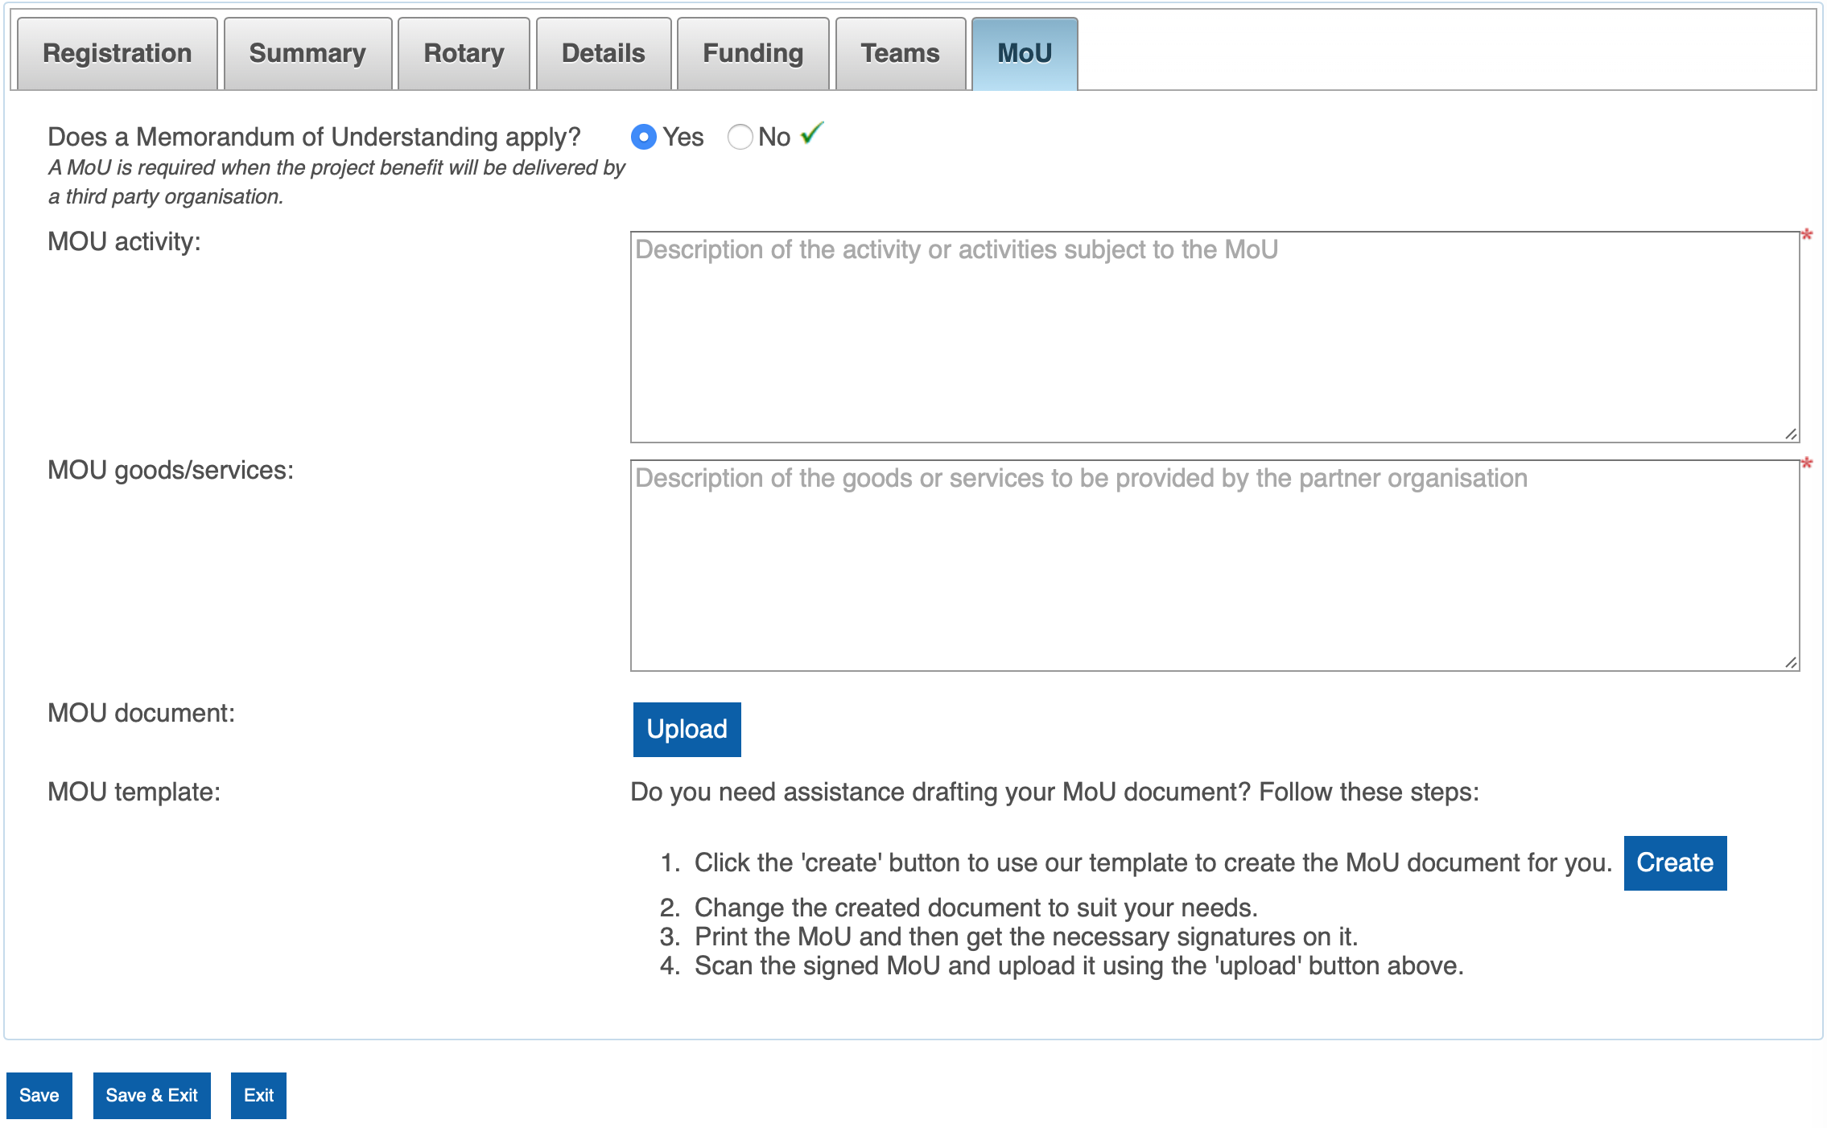
Notes:
Does your project require an MOU?
A MOU is required if the delivery of the Project will be undertaken by a non-Rotary entity
Click on “YES” and enter details.
You have the option to upload a signed MOU that you provide or CREATE one from this program that will have some information already incorporated into it from the details you have already provided.
The MOU created is a Word document that should be edited as required.

Slide 27
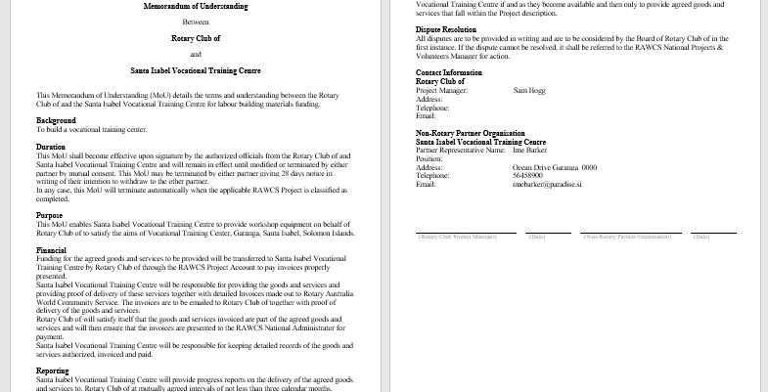
Notes:
This is an example of the MOU produced.

Slide 28
Once completed remember to SAVE. Do a final check to ensure all red asterisks have turned to green ticks.
When satisfied, click on SUBMIT on the first page and wait until the program notifies you that it has submitted to the National Projects Manager and the other signatories for their approvals.
Once signed by all the signatories the project will be registered and you will be notified by email.

Slide 29
If you have any problems or questions please contact your RAWCS District Chair or Regional Projects Manager.
Their contact email addresses are listed on our website at:
http://rawcs.org.au/about-us/
Notes:
Any questions?
Look at the website for contact details.
Remember you can contact your RAWCS District Chair, our your Regional Projects Manager for assistance or to report any problems with the website.

