Slide 1
RAWCS Crowdfunding
PP John Roberson – March 2022

Slide 2
On the RAWCS website you can find the Register for Crowdfunding portal under the PROJECTS menu.
Click on “Register for Crowdfunding” and follow the directions.

Slide 3
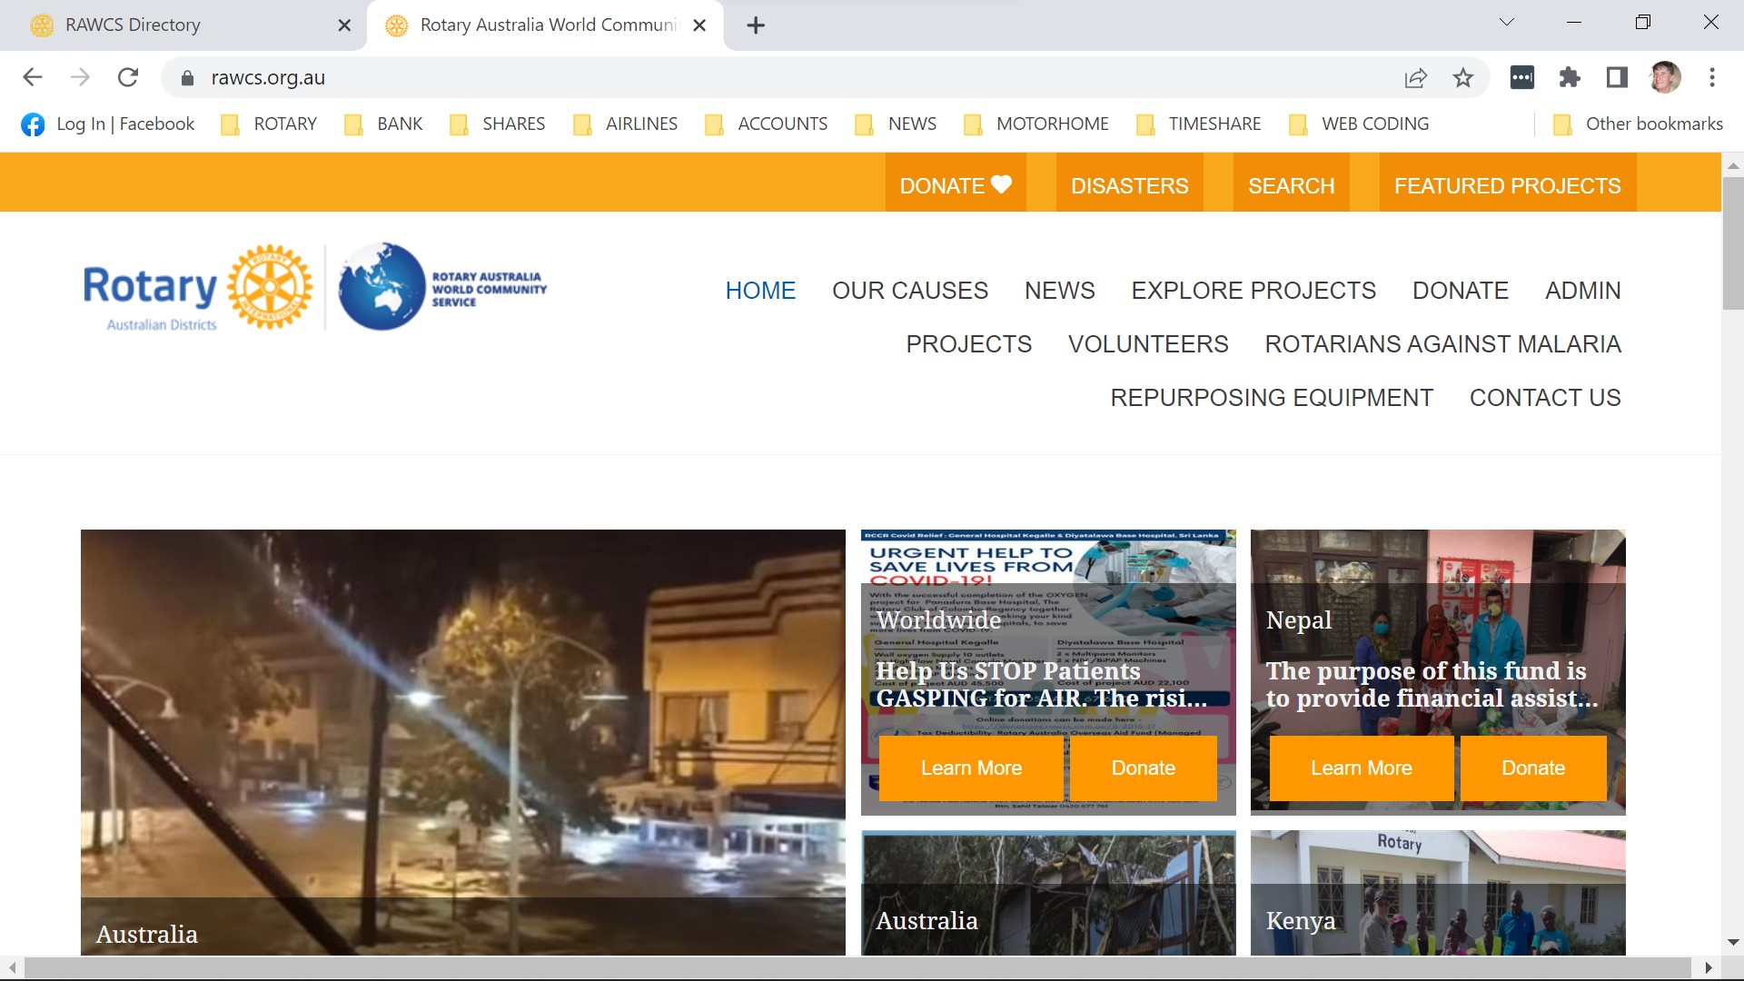
Notes:
The picture above show the RAWCS homepage - https://rawcs.org.au/
The Register for Crowdfunding Landing page is found on the RAWCS Homepage under menu item PROJECTS
Clicking on Register your Project for Crowdfunding will take you to the page to commence updating your project and registering your project for Crowdfunding.
Priority of Display - The website priority is used to determine where each project will appear on the RAWCS public website. There are three options:
Platinum. The platinum project will always appear first on the RAWCS public website. There can only be one platinum project at any one time.
Gold. Gold projects will always appear on the home page of the RAWCS public website, although the placement on this page is random. There can only be a maximum of three gold projects at any one time.
Silver. The vast majority of projects are classified as silver. They will randomly appear on the RAWCS home page.
Only selected users can set a project's website priority.

Slide 4
Notes:
On the Home page click on “Learn More” or “Featured Projects” to see how a project displays when it has been Crowdfunded – Example of Top of page
Access project details by clicking on Learn More on the crowdfunding Landing page.
Includes all pictures by rotation, uploaded by the Project Manager and the target, number of donors and amount raised so far of any appeal established as well as any suggested donation amounts for that project.

Slide 5
Notes:
Project Details – Example of Bottom of page
Contains the Summary, Challenge, Solution and Long Term Impact statements for the project.
Contact details and any additional information on the project uploaded by the Project Manager

Slide 6
RAWCS Crowdfunding Criteria
All projects must be sponsored by a Rotary Club and the Project Manager and Deputy Project Manager must be active members of the sponsoring Rotary Club.
Projects must have at least one other Committee member recorded in the RAWCS directory.
Desirable that a majority of the project management committee be active members of a Rotary Club.
All projects are subject to providing 6 monthly audit reports.
All donations received by any crowdfunded project will be processed through our existing donations website. They will be subject to the usual RAWCS accountability requirements.
All project must be registered with RAWCS and fulfil all the requirements of our current project Criteria for both Overseas Aid and Benevolent Society Projects.
Once approved and in operation we will integrate the Crowdfunding facility with the current online registration facility.
We want all existing Project Managers to develop their project so that what is presented to the public meets our strict guidelines and markets their project.
Notes:
RAWCS Crowdfunding Criteria
All projects must be sponsored by a Rotary Club and the Project Manager and Deputy Project Manager must be active members of the sponsoring Rotary Club.
Projects must have at least one other Committee member recorded in the RAWCS directory.
Desirable that a majority of the project management committee be active members of a Rotary Club.
All projects are subject to providing 6 monthly audit reports.
All donations received by any crowdfunded project will be processed through our existing donations website. They will be subject to the usual RAWCS accountability requirements.
All project must be registered with RAWCS and fulfil all the requirements of our current project Criteria for both Overseas Aid and Benevolent Society Projects.
Once approved and in operation we will integrate the Crowdfunding facility with the current online registration facility.
We want all existing Project Managers to develop their project so that what is presented to the public meets our strict guidelines and markets their project.

Slide 7
The next slides show the actual screen shots of what a Project Manager sees when they Login to update their project

Slide 8
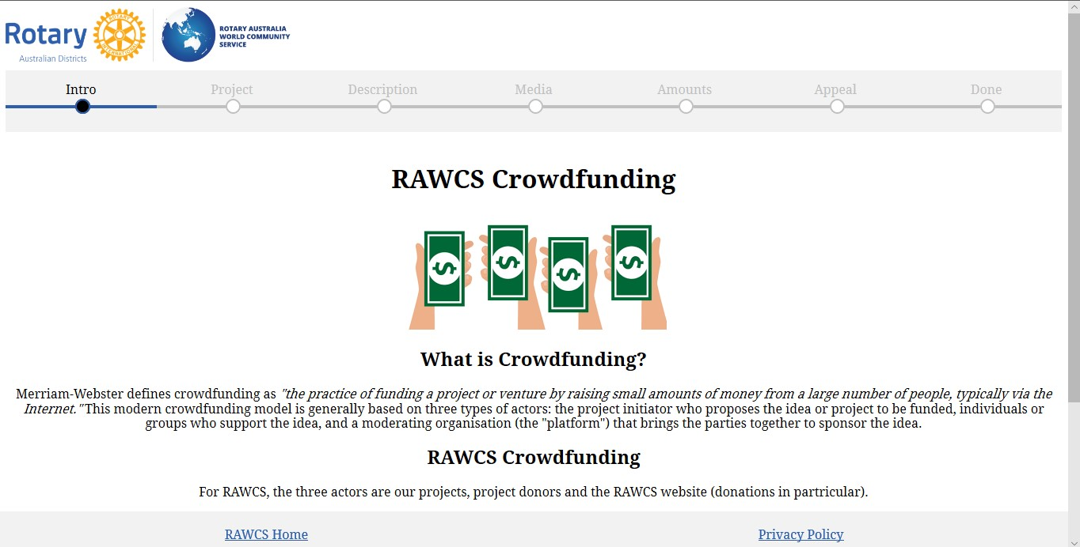
Notes:
Top of Introduction Page
What is Crowdfunding?
Merriam-Webster defines crowdfunding as "the practice of funding a project or venture by raising small amounts of money from a large number of people, typically via the Internet." This modern crowdfunding model is generally based on three types of actors: the project initiator who proposes the idea or project to be funded, individuals or groups who support the idea, and a moderating organisation (the "platform") that brings the parties together to sponsor the idea.
RAWCS Crowdfunding
For RAWCS, the three actors are our projects, project donors and the RAWCS website (donations in particular).
RAWCS has developed a new landing page for its website - rawcs.org.au - which will become live in September 2019. This new landing page will showcase our projects using photos, text and other information supplied by project managers. The aim is to make our website as attractive to potential donors as other crowdfunding sites such as GoFundMe.
Project Managers - we need your help!
We need you to help us help you. Use this page, by clicking on Next Step below, to revise the description of your project to make it interesting to potential donors, add some photos and perhaps suggest donation amounts and set up an appeal. Each step of the process contains some helpful hints to guide you along the way.

Slide 9
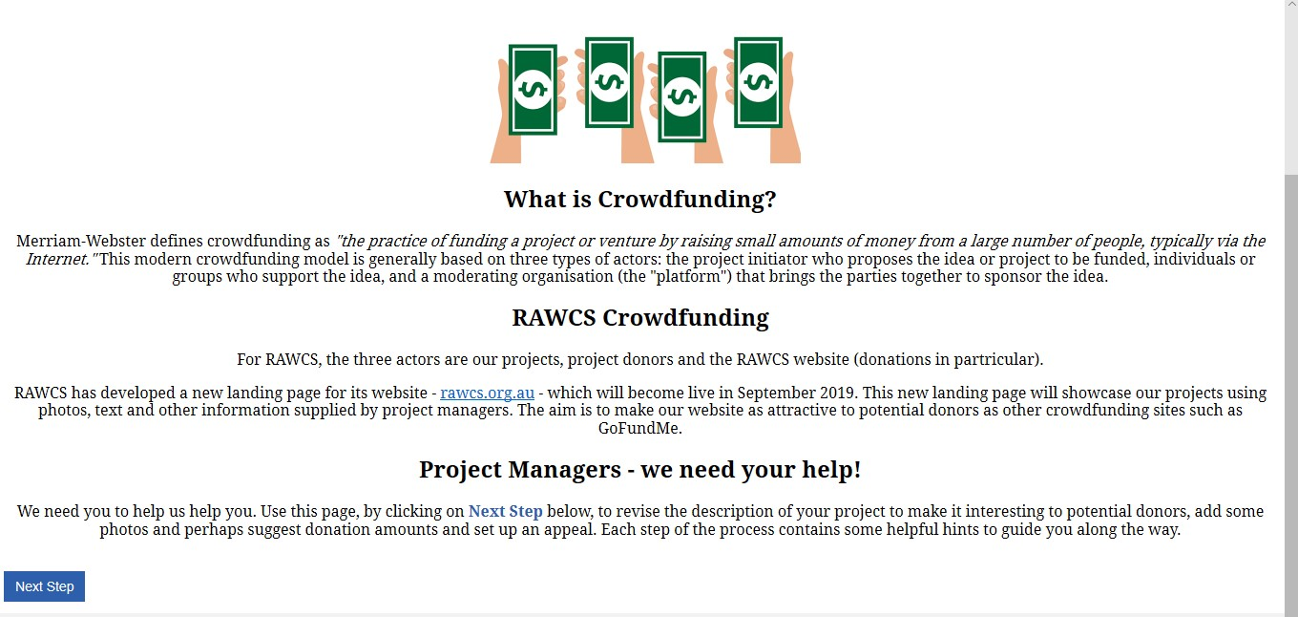
Notes:
Bottom of Introduction page

Slide 10
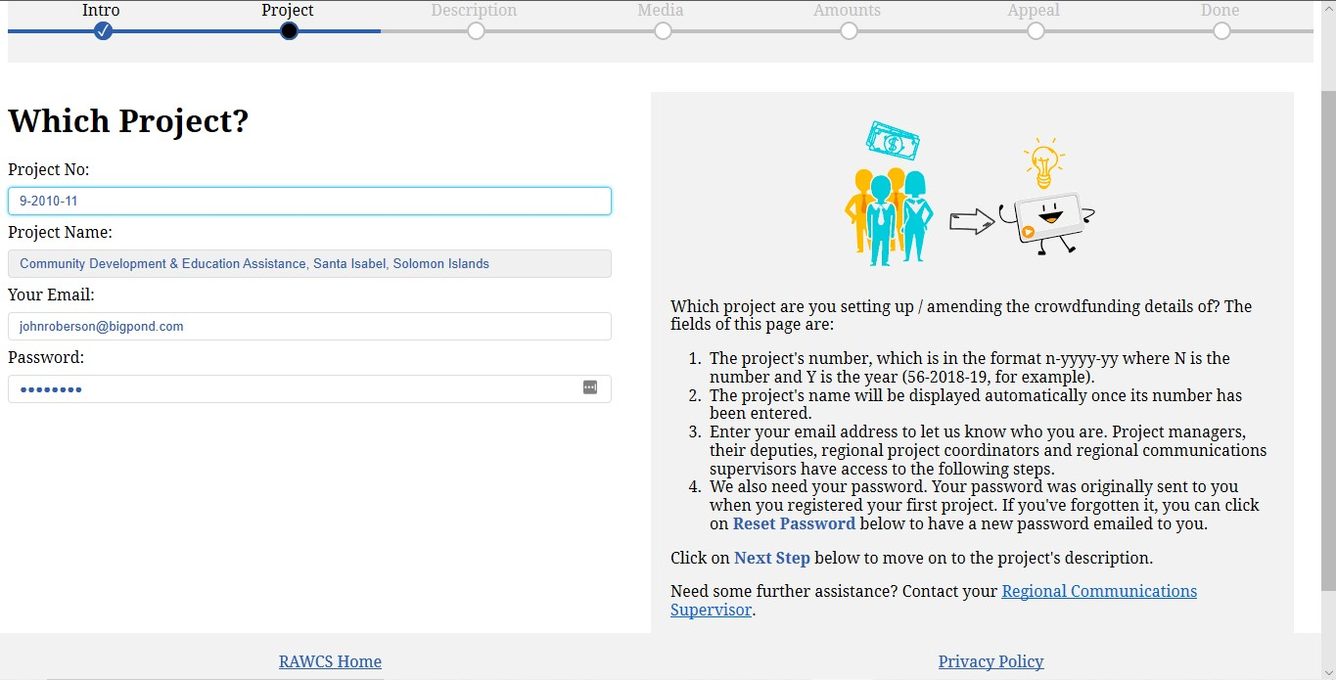
Notes:
Top of Project Page
Which project are you setting up / amending the crowdfunding details of? The fields of this page are:
The project's number, which is in the format n-yyyy-yy where N is the number and Y is the year (56-2018-19, for example).
The project's name will be displayed automatically once its number has been entered.
Enter your email address to let us know who you are. Project managers, their deputies, regional project coordinators and regional communications supervisors have access to the following steps.
We also need your password. Your password was originally sent to you when you registered your first project. If you've forgotten it, you can click on Reset Password below to have a new password emailed to you.
Click on Next Step below to move on to the project's description.
Need some further assistance? Contact your Regional Communications Supervisor.

Slide 11
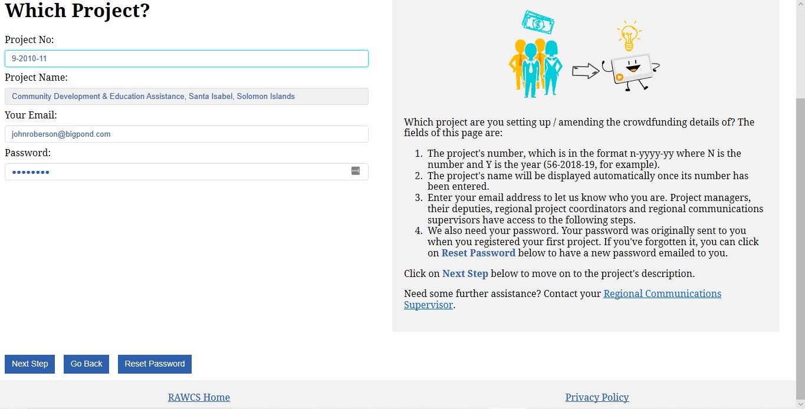
Notes:
Bottom of Project page

Slide 12
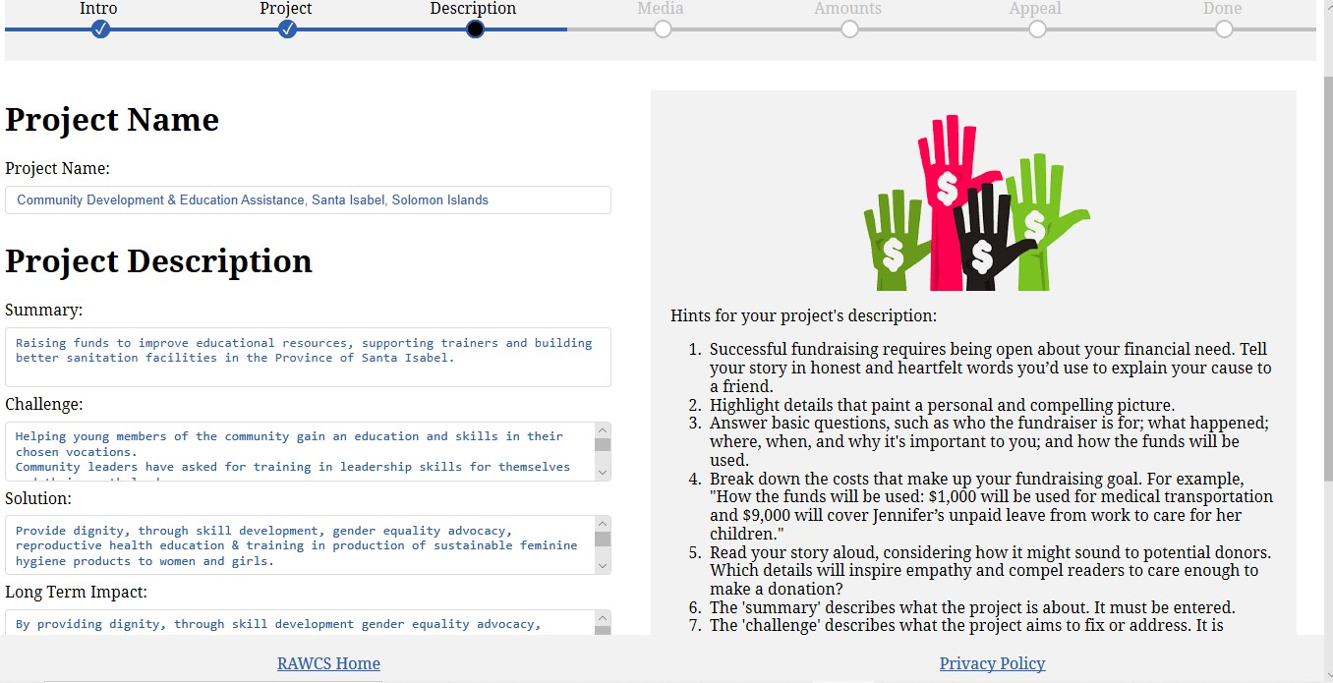
Notes:
Top of Description Page
Hints for your project's description:
Successful fundraising requires being open about your financial need. Tell your story in honest and heartfelt words you’d use to explain your cause to a friend.
Highlight details that paint a personal and compelling picture.
Answer basic questions, such as who the fundraiser is for; what happened; where, when, and why it's important to you; and how the funds will be used.
Break down the costs that make up your fundraising goal. For example, "How the funds will be used: $1,000 will be used for medical transportation and $9,000 will cover Jennifer’s unpaid leave from work to care for her children."
Read your story aloud, considering how it might sound to potential donors. Which details will inspire empathy and compel readers to care enough to make a donation?
The 'summary' describes what the project is about. It must be entered.
The 'challenge' describes what the project aims to fix or address. It is optional.
The 'solution' describes what your project will do to address the challenge. It is optional.
The 'long term impact' describes what the long-term impact of the project will be. It is optional.
All changes proposed will be reviewed by RAWCS before appearing on the crowdfunding platform. (This will probably be by members of the Communications and Website Committees – yet to be decided)
Review the Project Name so that it is more suitable for marketing their project (we will not require the country to be stated as the Country where the project is located will be automatically printed on their promotional project picture)
Review their present Project Description to better market their project.
Enter a Summary of their project that succinctly describes and markets their project.
Enter a Challenge that their project plans to assist with
Enter their proposed Solution to address the Challenge stated above
Enter a Long-Term Impact that explains how their solution will impact the challenge in the long term. In other words, how will this make their project sustainable in the long term without permanent funding.

Slide 13
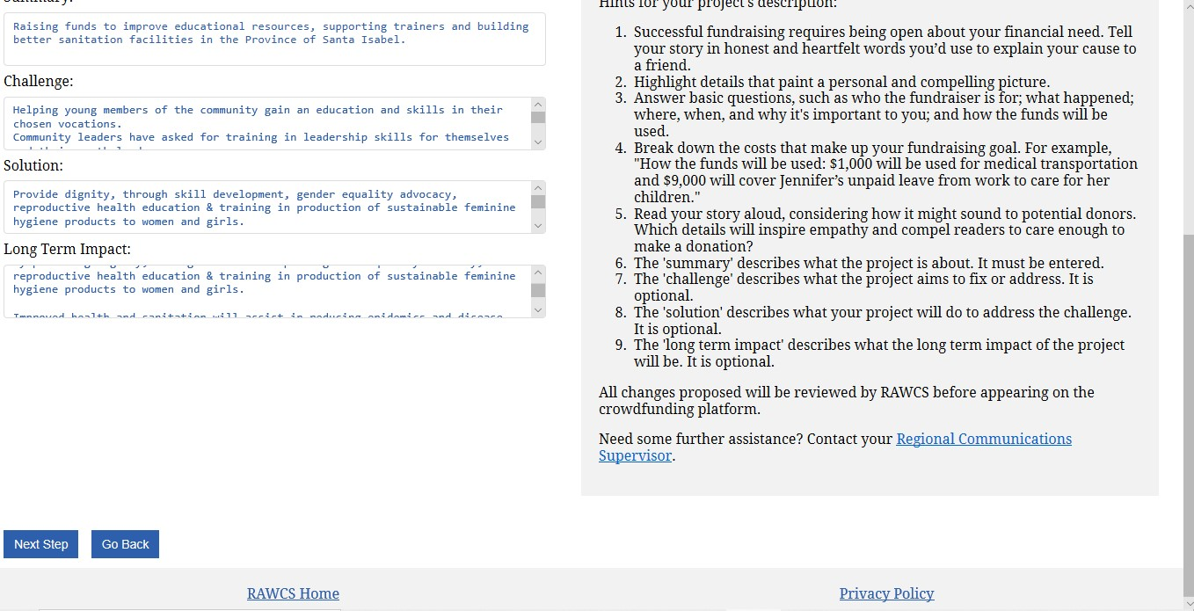
Notes:
Bottom of the Project page

Slide 14
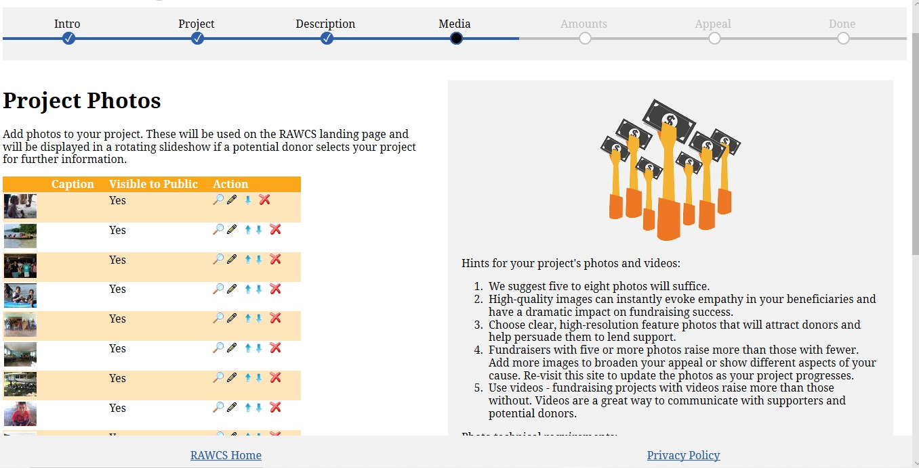
Notes:
Top of Media page
Hints for your project's photos and videos:
We suggest five to eight photos will suffice.
High-quality images can instantly evoke empathy in your beneficiaries and have a dramatic impact on fundraising success.
Choose clear, high-resolution feature photos that will attract donors and help persuade them to lend support.
Fundraisers with five or more photos raise more than those with fewer. Add more images to broaden your appeal or show different aspects of your cause. Re-visit this site to update the photos as your project progresses.
Use videos - fundraising projects with videos raise more than those without. Videos are a great way to communicate with supporters and potential donors.
Photo technical requirements:
Photos must have a 4:3 aspect ratio, in landscape orientation. EG 4032x3024, 3968x2976, 2560x1920, 1920x1440 and 800x600 all have a 4:3 aspect ratio. We have prepared these instructions to assist with cropping and re-sizing photos.
PNG and JPEG files are acceptable.
Each file must be 6MB, or less, in size.

Slide 15
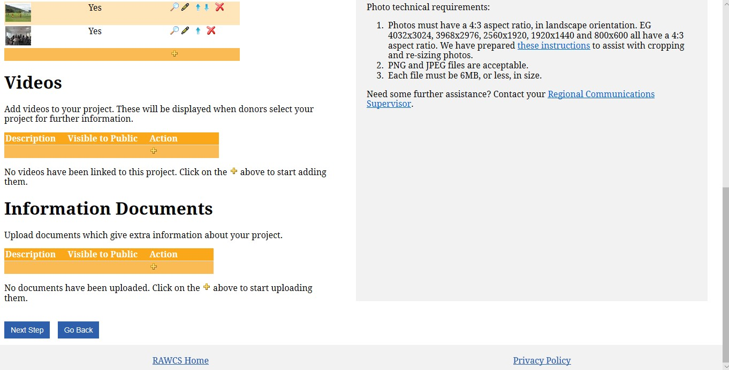
Notes:
Bottom of Media page
Add Video as in the note on the upload page:
Enter video URL in the box
A typical YouTube URL will look similar to https://youtu.be/NAvW3kp48HY or https://www.youtube.com/watch?v=NAvW3kp48HY, and a Vimeo one like https://vimeo.com/256892640.
Information Documents
Upload documents that further explain your project. Preferably in PDF format and no larger than 6MB

Slide 16
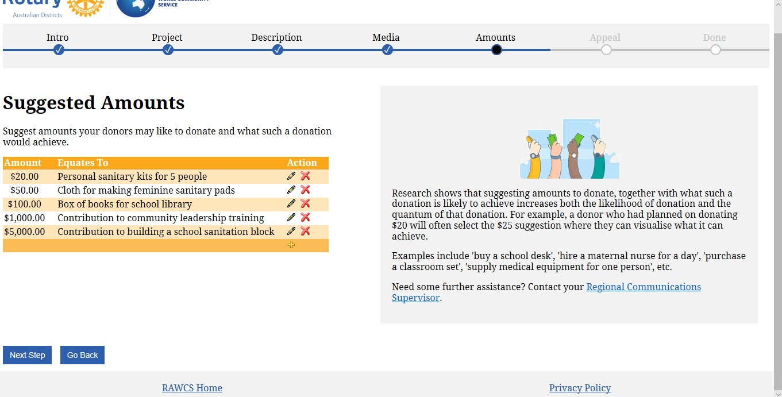
Notes:
Amounts page
Suggest amounts your donors may like to donate and what such a donation would achieve.
Headings are – Amounts and Equates To
Notes are:
Research shows that suggesting amounts to donate, together with what such a donation is likely to achieve increases both the likelihood of donation and the quantum of that donation. For example, a donor who had planned on donating $20 will often select the $25 suggestion where they can visualise what it can achieve.
Examples include 'buy a school desk', 'hire a maternal nurse for a day', 'purchase a classroom set', 'supply medical equipment for one person', etc.

Slide 17
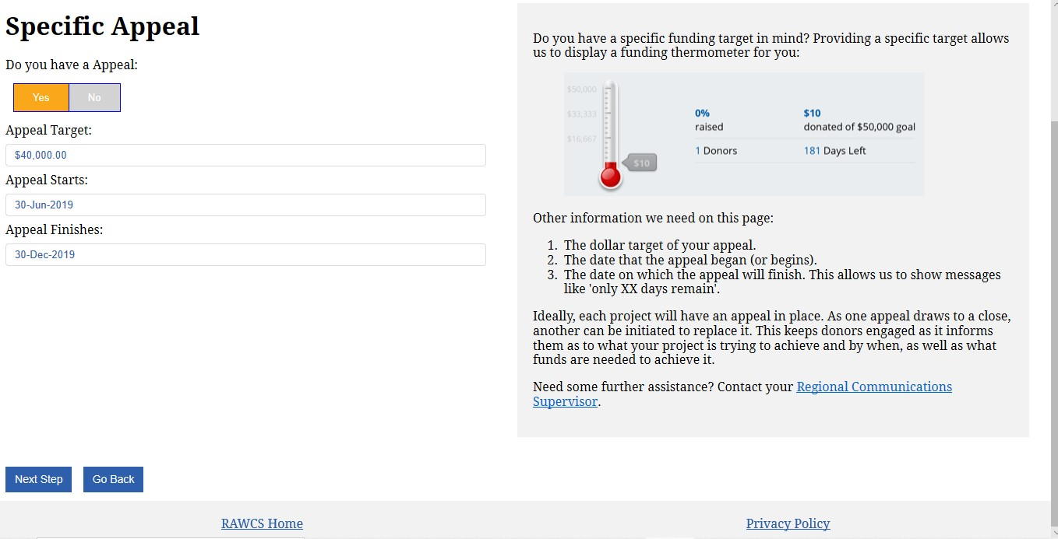
Notes:
Appeal page
Do you have a specific funding target in mind? Providing a specific target allows us to display a funding thermometer for you:
Other information we need on this page:
The dollar target of your appeal.
The date that the appeal began (or begins).
The date on which the appeal will finish. This allows us to show messages like 'only XX days remain'.
Ideally, each project will have an appeal in place. As one appeal draws to a close, another can be initiated to replace it. This keeps donors engaged as it informs them as to what your project is trying to achieve and by when, as well as what funds are needed to achieve it.

Slide 18
Notes:
Top of Summary page
Summary of all that has been entered as it will be displayed on the website when approved.

Slide 19
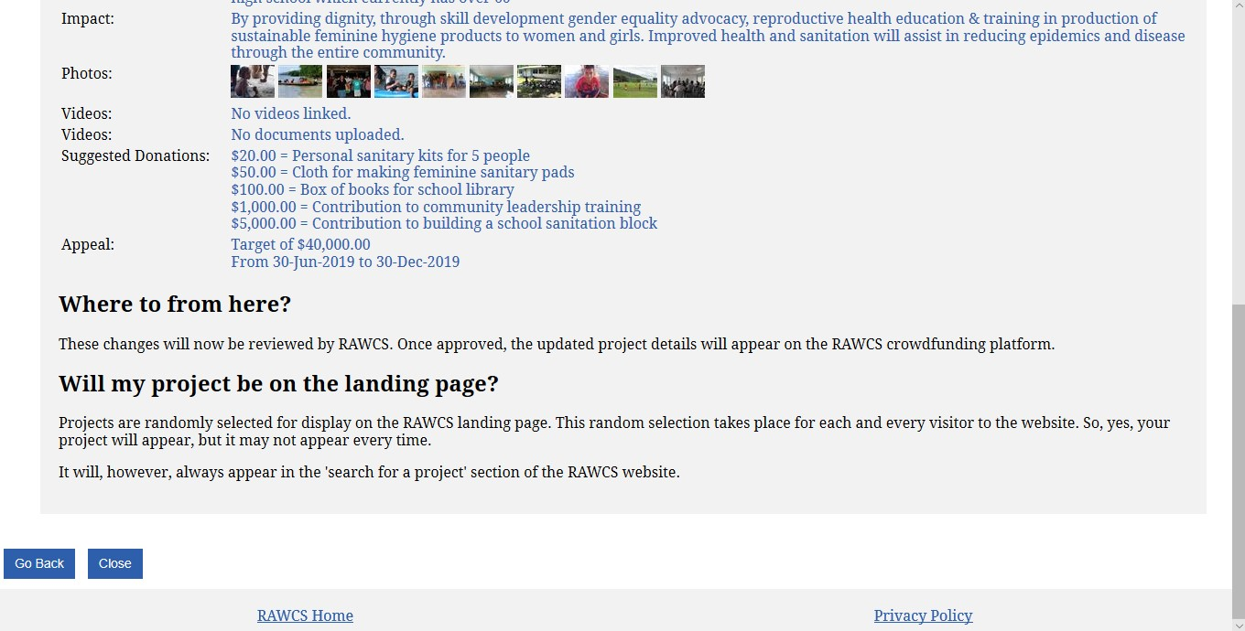
Notes:
Bottom of Summary page
Where to from here?
These changes will now be reviewed by RAWCS. Once approved, the updated project details will appear on the RAWCS crowdfunding platform.
Will my project be on the landing page?
Projects are randomly selected for display on the RAWCS landing page. This random selection takes place for each and every visitor to the website. So, yes, your project will appear, but it may not appear every time.
It will, however, always appear in the 'search for a project' section of the RAWCS website.

Slide 20
Now it is up to Project Managers to update their Project.
Be creative with what you write about your project as it will sell your project to the Public.
Remember to upload quality images that market your project.
Please be patient waiting on the RAWCS personnel to approve your project update before they allow it to be live on the website.

Slide 21
Any Questions?

